Slide 1
Os Assignment 4
Sachin Rajbhar
41221139
BCA 2nd SEM

Slide 2
Demonstrate, how the following can run on a windows environment
Oracle virtual machine
Linux/ Unix
Ubuntu
Determine the space requirement in each case

Slide 3
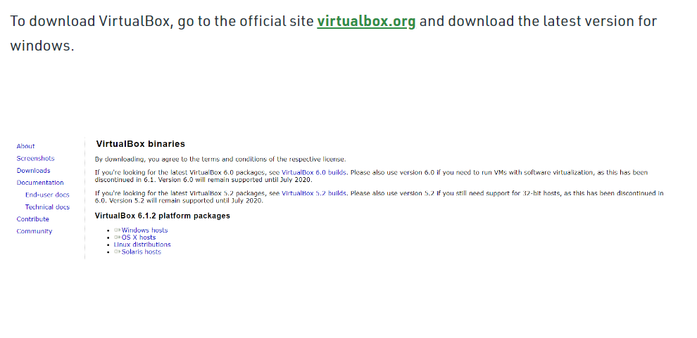
How to Install VirtualBox on Windows?

Slide 4
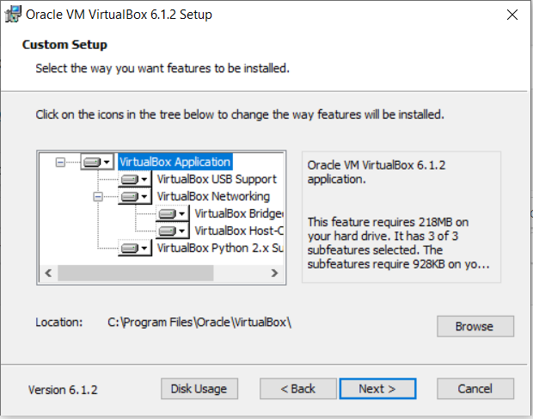
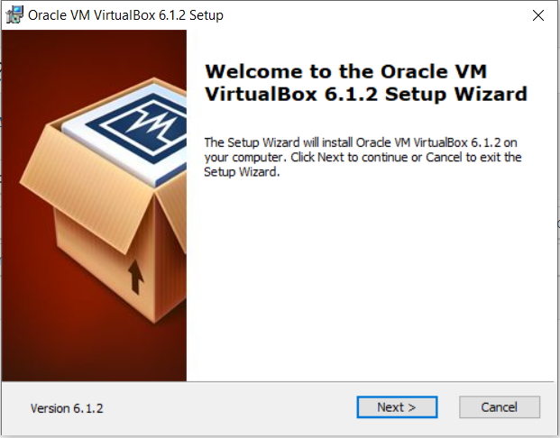
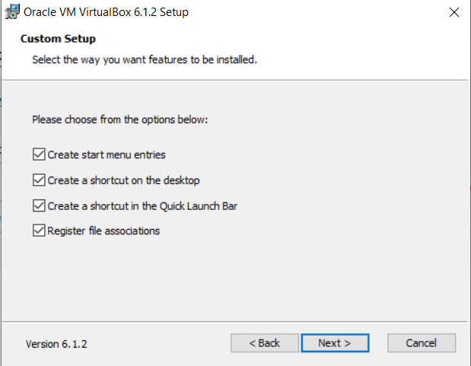
Beginning with the Installation:
Getting Started:

Slide 5
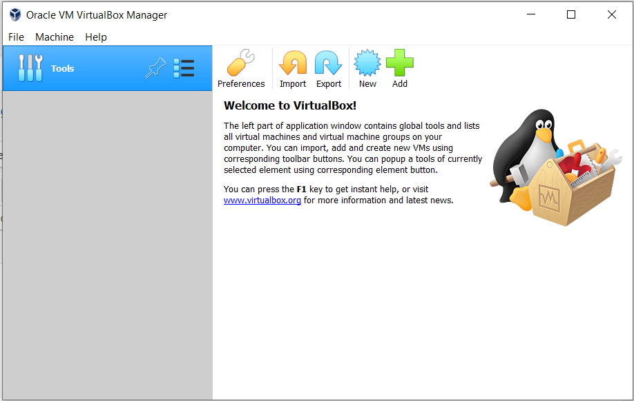
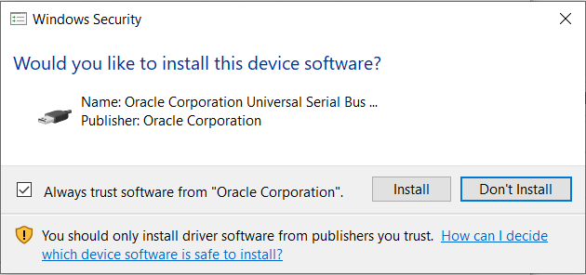
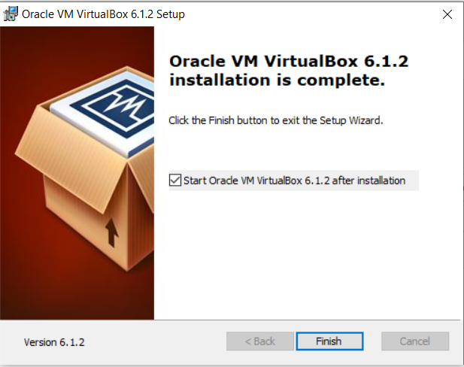
Installing certificates
Finishing Installation

Slide 6
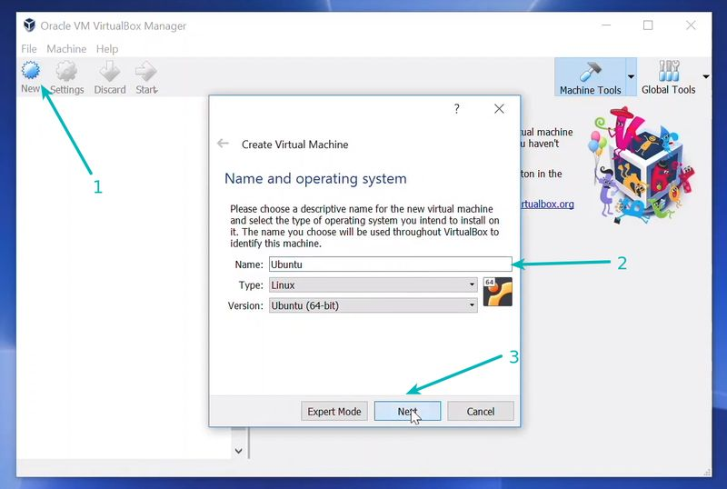
How to setup Linux/Unix/Ubuntu
Step 1: Download and install VirtualBox
Step 2: Download the Linux ISO
Step 3: Install Linux using VirtualBox

Slide 7
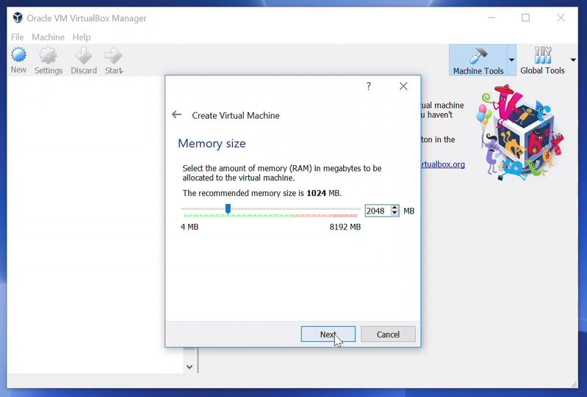
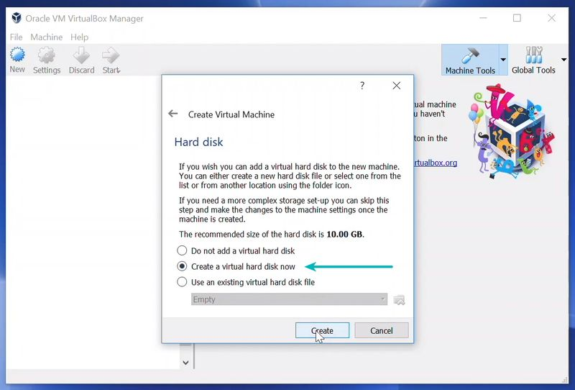
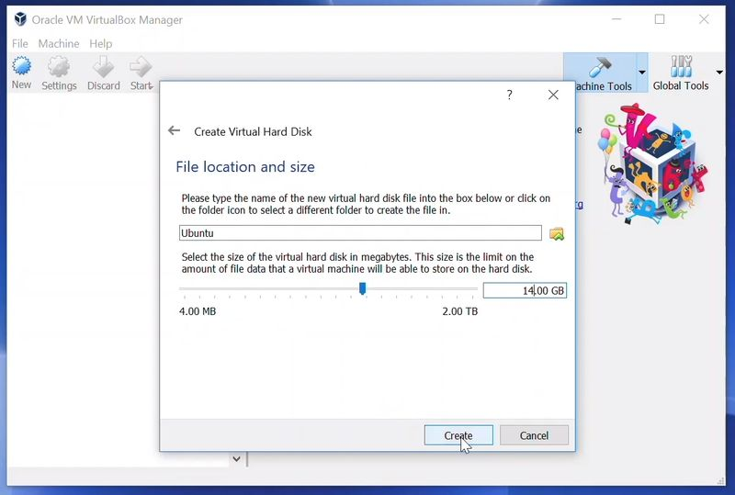
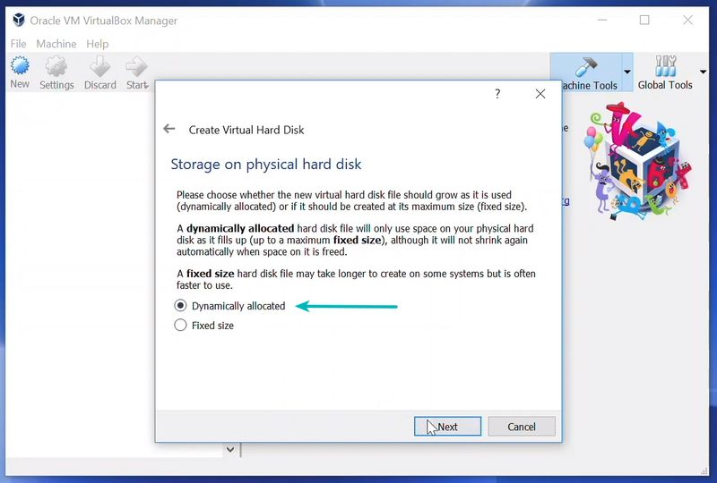
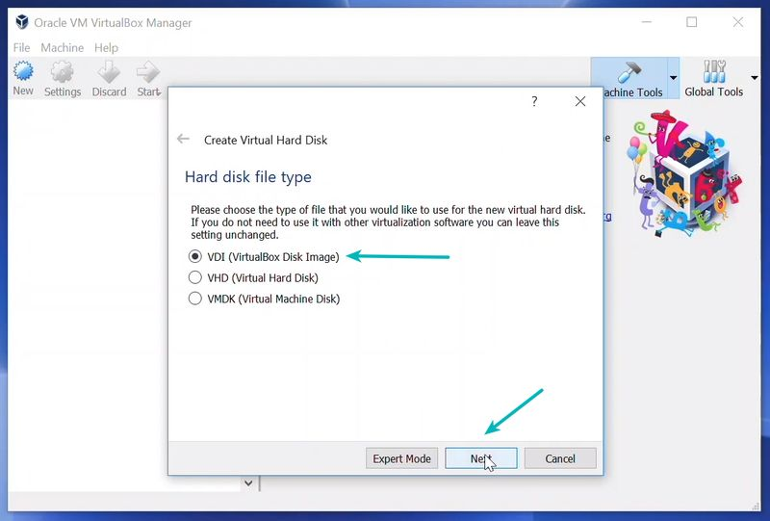


Slide 8
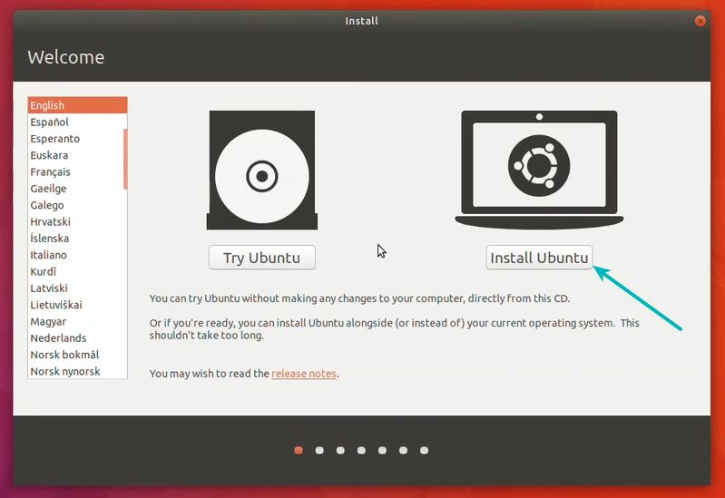
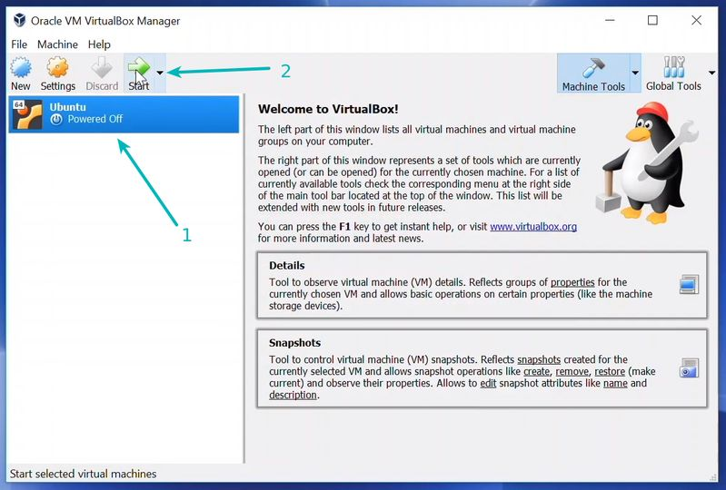
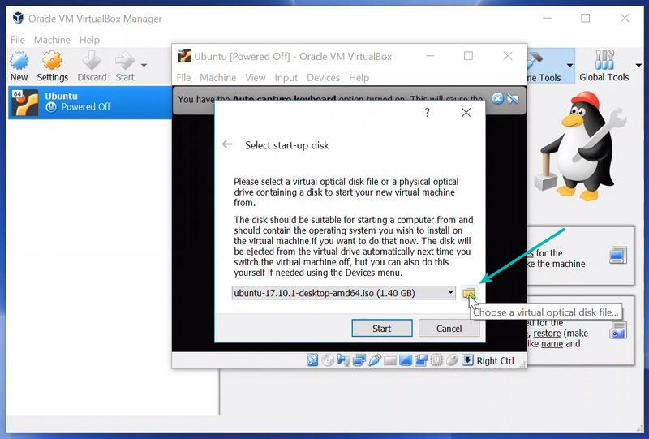
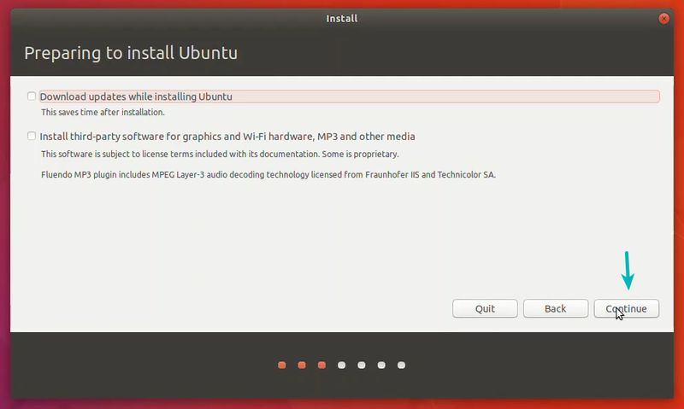

Once everything is in place, it’s time to boot that ISO and install Linux as a virtual operating system.

Slide 9
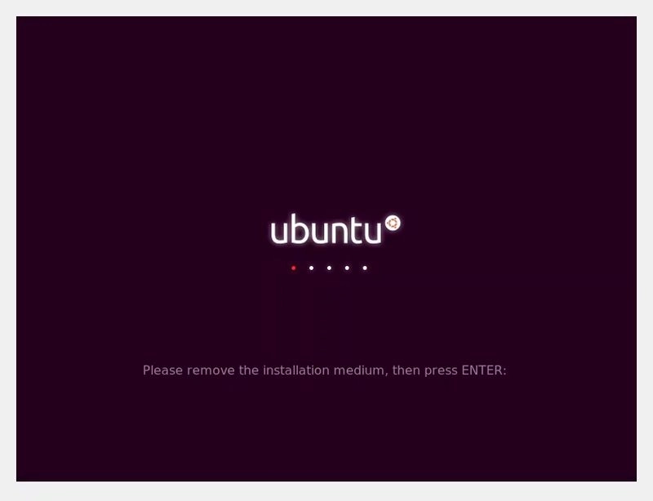
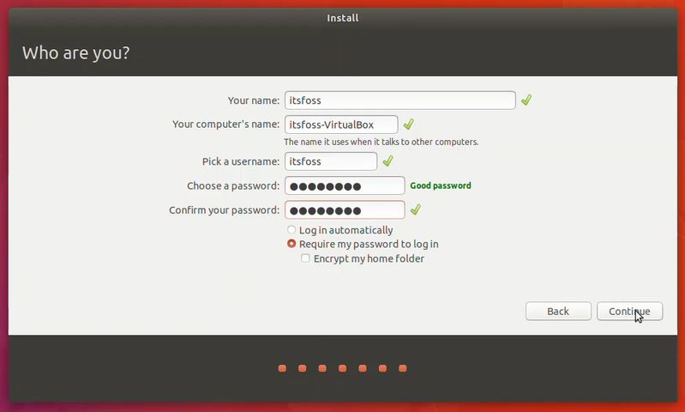
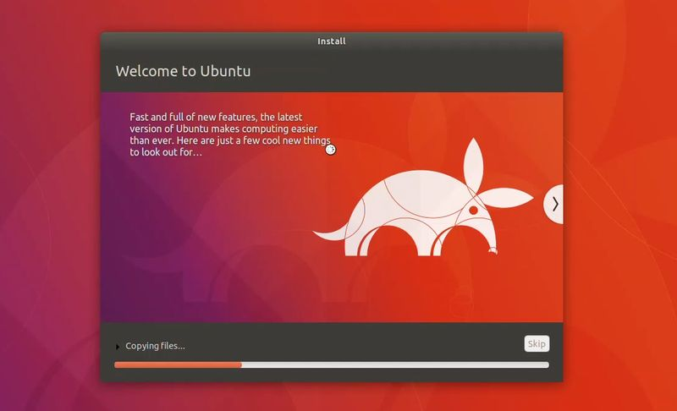
SET UP

Slide 10
Memory Space Requirements
Virtual Box: 30 MB of hard disk space
i) Linux: 4 GB free space
ii) Unix: 8 GB free space
iii) Ubuntu: 8.6 GB free space

Slide 11


